Slide 1
CursorAdapter, CursorLoader
Indra Azimi, S.T., M.T.
D3 Teknik Informatika, Telkom University

Slide 2
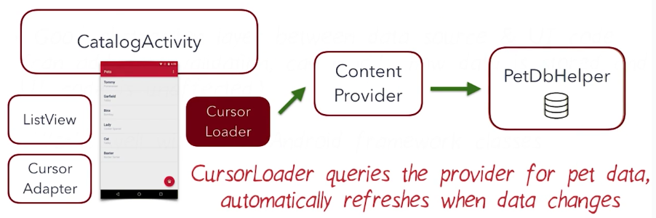
Our Goal

Slide 3
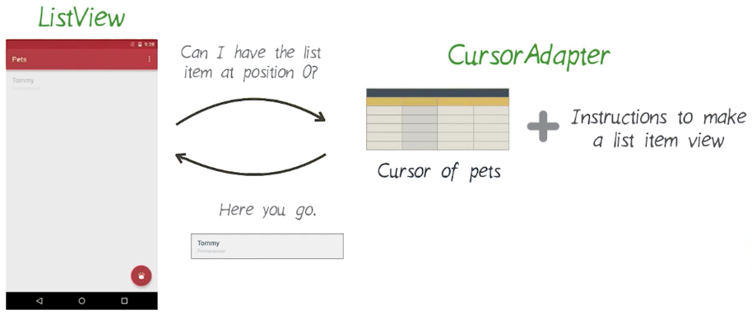
Cursor Adapter

Slide 4
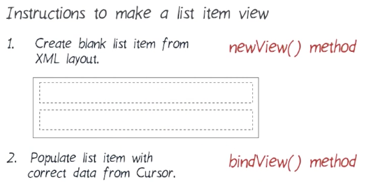
Cursor Adapter (2)
Need tutorial? https://github.com/codepath/android_guides/wiki/ Populating-a-ListView-with-a-CursorAdapter

Slide 5
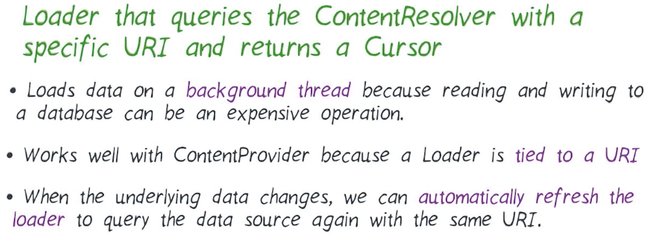
Cursor Loader
https://developer.android.com/guide/components/loaders.html

Slide 6
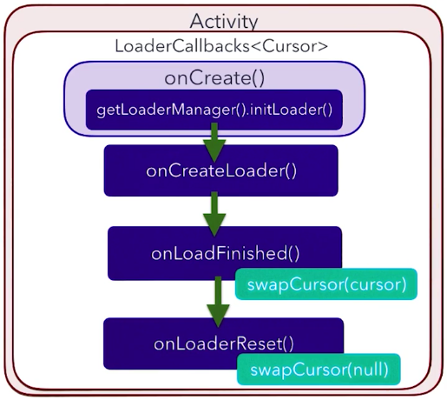
Cursor Loader (2)

Slide 7
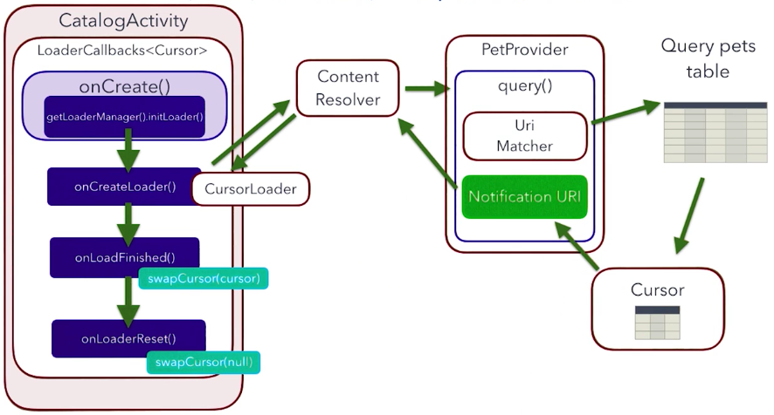

Slide 8


Cursor Loader: Auto Load

Slide 9
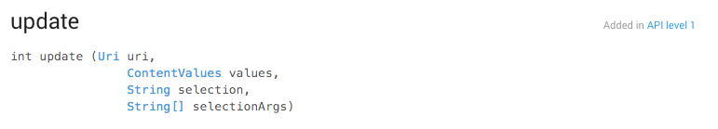
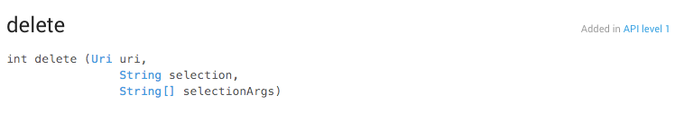
Update & Delete

Slide 10
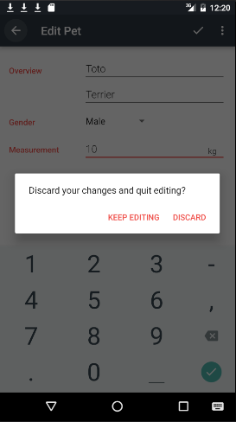
Alert Dialog
A dialog is a small window that prompts the user to make a decision or enter additional information.
A dialog does not fill the screen and is normally used for modal events that require users to take an action before they can proceed.
https://developer.android.com/guide/topics/ui/dialogs.html

Slide 11
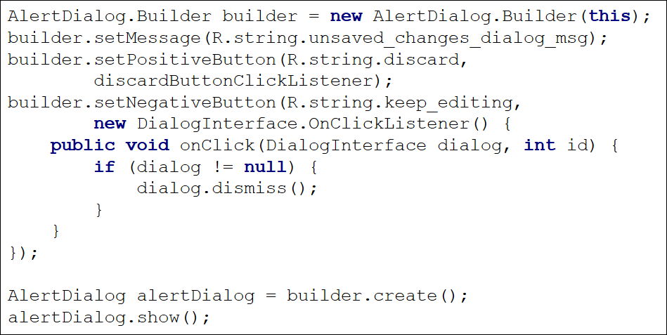
Alert Dialog (2)

Slide 12
Referensi
Lesson 4: Loading data using CursorLoader
Android Basics: Data Storage
https://www.udacity.com/course/ud8435

